Slide 1
GSE Algebra I
Unit 8/9 Review

Slide 2
Unit 5: Comparing and Contrasting Functions
Key Ideas
Construct and Compare Linear, Quadratic, and Exponential Models and Solve Problems
Interpret Expressions for Functions in Terms of the Situation They Model
Build New Functions from Existing Functions
Understand the Concept of a Function and Use Function Notation
Interpret Functions that Arise in Applications in Terms of the Context

Slide 3
Construct and Compare Linear, Quadratic, and Exponential Models and Solve Problems
Recognize linear and exponential growth rates
Linear = constant rate of change
Exponential = common ratio (multiplying/dividing by same amount each time)
An exponential will eventually exceed all other functions

Slide 4
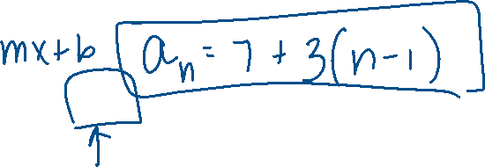
Ex 1: Given the sequence 7, 10, 13, 16… a. Does it appear to be linear or exponential? b. Determine a function to describe the sequence. c. What would the 20th term of the sequence be?

Slide 5
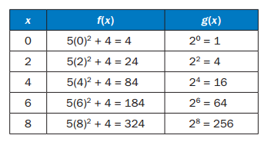
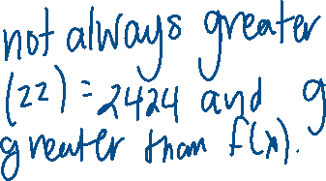
Ex 2: This table shows that the value of f(x) = 5x² + 4 is greater than the value of g(x) = 2^{x} over the interval [0, 8]. As x increase, will the value of f(x) always be greater than the value of g(x)? Explain how you know.

Slide 6
Interpret Expressions for Functions in Terms of the Situation They Model
A parameter is the independent variable or variables in a system of equations with more than one dependent variable.
A parameter as a constant term generally affects the intercepts.
If the parameter is a coefficient, in general it will affect the rate of change.

Slide 7
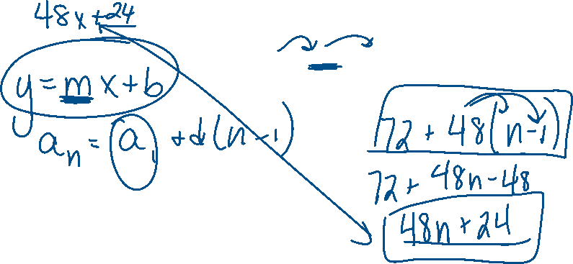
Ex 3: Alice finds that her flower bulbs multiply each year. She started with just 24 tulip plants. After one year she had 72 plants. Two years later she had 120. Find a linear function to model the growth of Alice’s bulbs.

Slide 8
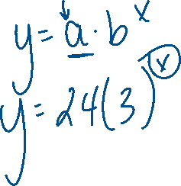
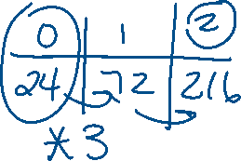
Ex 4: Suppose Alice discovers she counted wrong the second year and she actually had 216 tulip plants. She realizes the growth is not linear because the rate of change was not the same. She must use an exponential model for the growth of her tulip bulbs. Find the exponential function to model the growth.

Slide 9
Build New Functions from Existing Functions
Parent Functions:
Linear: f(x) = x
Quadratic: g(x) = x²
Exponential: h(x) = 2^{x}
Transformations: Reflection, Stretch, Shrink, Translation

Slide 10
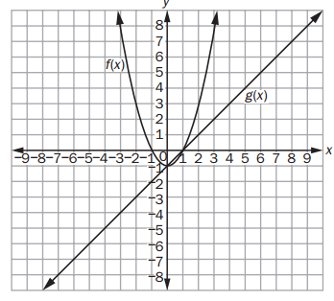
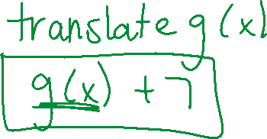
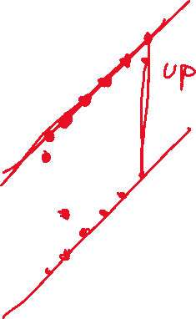
Ex 5: Look at the graphs of the function f(x) = x² – 1 and g(x) = x –1. What transformation makes g(x) > f(x) for -2 < x < 3?

Slide 11
Ex 6: As the input x increases by a factor of 3, the output g(x) doubles. What type of functions fits this situation?

Slide 12
Interpret Functions in Context
Continuous vs Discrete
When examining a function, we look at the following features:
Domain
Range
x-intercept/root/zero
y-intercept
interval of increasing, decreasing, constant
Minimum or Maximum
Average Rate of Change
End Behavior

Slide 13
Ex 7: Roger is washing cars for people in his neighborhood. He bought cleaning supplies with his own money before he began washing cars. He charges a flat fee of $15 for each car washed. Roger’s total amount of profit, y, in dollars, for washing x cars can be modeled by the function y = 15x – 40. a. What is the domain of this function? b. What does the y-intercept of this function represent?

Slide 14
Unit 6: Describing Data
Key Ideas
Summarize, Represent, and Interpret Data on a Single Count or Measurable Variable
Summarize, Represent, and Interpret Data on Two Categorical and Quantitative Variables
Interpret Linear Models

Slide 15
Summarize, Represent, and Interpret Data on a Single Count or Measurable Variable
Measures of Central Tendency
Mean
Median
First Quartile (Lower Quartile): Q₁
Third Quartile (Upper Quartile): Q₃
Interquartile Range
Box Plot: 5 Number Summary

Slide 16
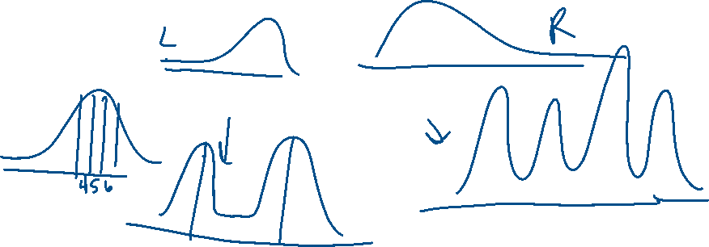
Summarize, Represent, and Interpret Data on a Single Count or Measurable Variable
Histogram
Outliers: below Q₁ – 1.5(IQR) or above Q₃ + 1.5(IQR)
Mean Absolute Deviation (MAD)
Skewness
Unimodal, Bimodal, Multimodal

Slide 17
Interpret Expressions for Functions in Terms of the Situation They Model
A parameter is the independent variable or variables in a system of equations with more than one dependent variable.
A parameter as a constant term generally affects the intercepts.
If the parameter is a coefficient, in general it will affect the rate of change.

Slide 18
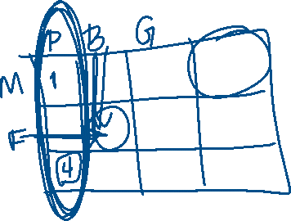
Summarize, Represent, and Interpret Data on Two Categorical and Quantitative Variables
Categorical vs Quantitative
Bivariate Data – Can be displayed with a two-way frequency chart
Joint Frequency
Marginal Frequency
Conditional Frequency

Slide 19
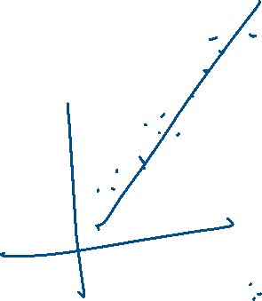
Summarize, Represent, and Interpret Data on Two Categorical and Quantitative Variables
Scatter Plot
Line of Best Fit
Regression
Correlation Coefficient
Correlation vs Causation

Slide 20
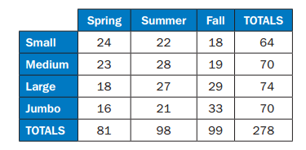
Ex 1: A fast-food restaurant wants to determine whether the season of the year affects the choice of soft-drink size purchased. It surveyed 278 customers, and the table shows its results. a. In which season did the most customers prefer jumbo drinks? b. What percentage of those surveyed purchased small drinks? c. What percentage of those surveyed purchased medium drinks in the summer? d. What do you think the fast-food restaurant learned from its survey?

Slide 21
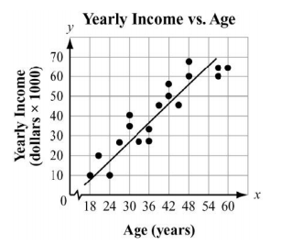
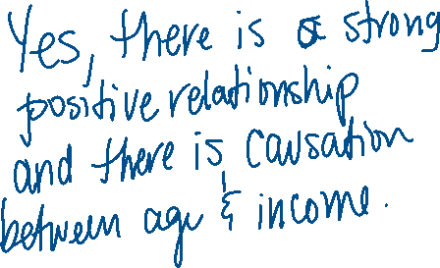
Ex 2: This scatter plot suggest a relationship between the variables age and income. A. What type of relationship is suggested by the scatter plot (positive/negative, weak/strong)? B. What is the domain of ages considered by the researchers? C. What is the range of incomes? D. Do you think age causes income level to increase? Why or why not?

