Slide 1
GSE Algebra I
Unit 7 Review

Slide 2
Unit 4: Modeling and Analyzing Exponential Functions
Key Ideas
Create Equations that Describe Numbers or Relationships
Build a Function that Models a Relationship Between Two Quantities
Build New Functions from Existing Functions
Understand the Concept of a Function and Use Function Notation
Interpret Functions that Arise in Applications in Terms of the Context
Analyze Functions Using Different Representations

Slide 3
Create Equations that Describe Numbers or Relationships
Exponential equations are of the form y = ab^{x} where a is the initial value and b is the common ratio.
Compound Interest: A = P(1 + r/n)^{nt}
P = principal (original amount)
r = interest rate (decimal)
n = number of compound periods per year
t = number of years

Slide 4
Ex 1: An amount of $1000 is deposited into a bank account that pays 4% interest compounded once a year. If there are no other withdrawals or deposits, what will be the balance of the account after 3 years?

Slide 5
Ex 2: The city of Arachna has a spider population that has been doubling every year. If there are about 100,000 spiders this year, how many will there be 4 years from now?

Slide 6
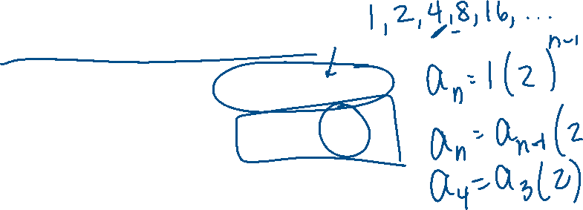
Build a Function that Models a Relationship Between Two Quantites
Geometric Sequences
Explicit Formula: a_{n} = a₁(r)^{n-1}
Recursive Formula: a_{n} = a_{n-1}(r)
Tips: Examine function values to draw conclusions about the rate of change. Keep in mind the general forms of an exponential function.

Slide 7
Ex 3: The temperature of a large tub of water that is currently 100 degrees decrease by 10% each hour. a. Write an explicit function in the form f(n) = ab^{n} to represent the temperature, f(n), of the tub of water in n hours. B. What recursive function represents the temperature, f(n), of the tub in hour n?

Slide 8
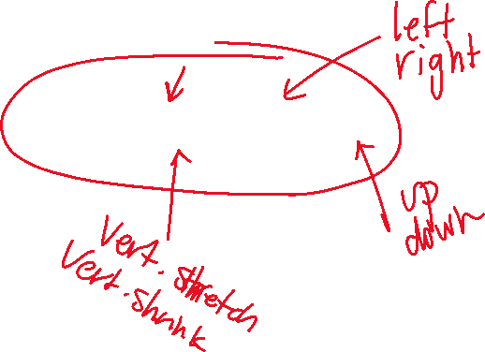
Build New Functions from Existing Functions
Transformations: Reflection, Stretch, Shrink, Translations (Shift Left, Right, Up, Down)
f(x) = a(b)^{x – h} + k

Slide 9
Ex 4: For the function f(x) = 3^{x}, find the function that represents a 5-unit translation up of the function.

Slide 10
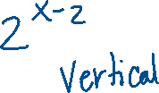
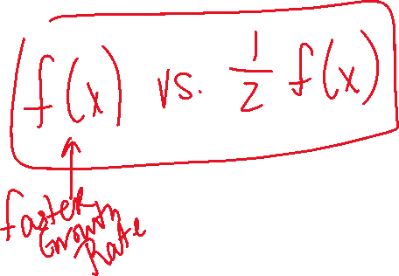
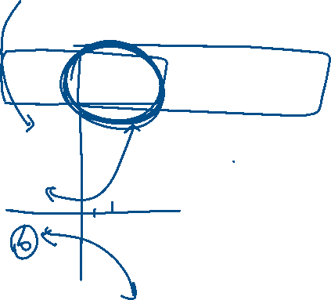
Ex 5: Given the function f(x) = 2^{(x-2)}, complete each of the following: a. Compare f(x) to 3f(x) b. Draw the graph of –f(x) c. Which has the fastest growth rate: f(x), 3f(x), or –f(x)?

Slide 11
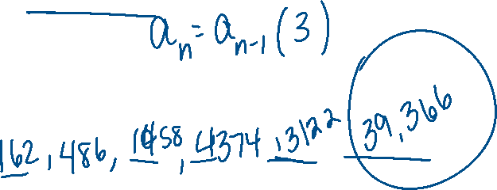
Ex 6: The population of bacteria begins with 2 bacteria on the first day and triples every day. a. What is the common ratio of the function? b. What is a₁ of the function? c. Write a recursive formula for the bacteria growth. d. What is the bacteria population after 10 days?

Slide 12
Interpret Functions in Context
When examining a function, we look at the following features:
Domain
Range
x-intercept/root/zero
y-intercept
interval of increasing, decreasing, constant
Minimum or Maximum
Average Rate of Change
End Behavior

Slide 13
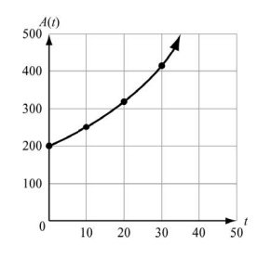
Ex 7: The amount accumulated in a bank account over a time period t and based on an initial deposit of $200 is found using the formula A(t) = 200(1.025)^{t}, t > 0. Time, t, is represented on the horizontal axis. The accumulated amount, A(t), is represented on the vertical axis.
a. What are the intercepts of the function? b. What is the domain of the function? c. Why are all the t-values non-negative? d. What is the range of the function?

Slide 14
Analyze Functions Using Different Representations
Be able to identify key features of a function regardless if you have the graph, table, or equation.
If you are comparing functions, create graphs or tables so you can see how each graph is changing.

Slide 15
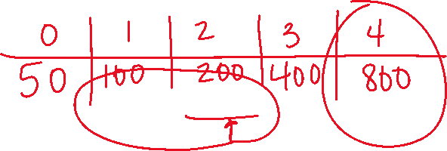
Ex 8: Two quantities increase at exponential rates. This table shows the value of Quantity A, f(x), after x years. This function represents Quantity B, g(x), after x years. g(x) = 50(2)^{x} Which quantity will be greater at the end of the four year and by how much?

