Slide 1
GSE Algebra I
Unit 4/5/6 Review

Slide 2
Unit 3: Modeling and Analyzing Quadratic Functions
Key Ideas
Interpret the Structure of Expressions
Write Expressions in Equivalent Forms to Solve Problems
Create Equations that Describe Numbers or Relationships
Solve Equations and Inequalities in One Variable
Build a Function that Models a Relationship Between Two Quantities
Build New Functions from Existing Functions
Interpret Functions That Arise in Applications in Terms of the Context
Analyze Functions Using Different Representations

Slide 3
Interpret the Structure of Expressions
If parts of an expression are independent of each other, the expression can be interpreted in different ways.
The structure of some expressions can be used to help rewrite them.
Ex: x² + 5x + 4 = (x + 1)(x + 4)

Slide 4
Write Expressions in Equivalent Forms to Solve Problems
The zeros, roots, or x-intercepts of a function are the values of the variable that make the function equal to zero.
Every quadratic has a minimum or a maximum which is located at the vertex (h, k). The vertex also identifies the axis of symmetry x = h.
The vertex form of a quadratic is f(x) = a(x – h)² + k
The standard form of a quadratic is f(x) = ax² + bx + c, where the axis of symmetry is –b/2a.

Slide 5
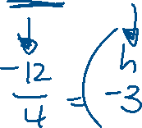
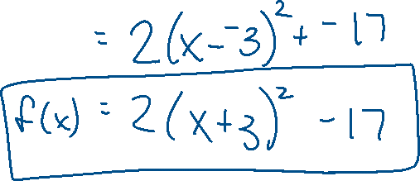
Ex 1: Write f(x) = 2x² + 12x + 1 in vertex form.

Slide 6
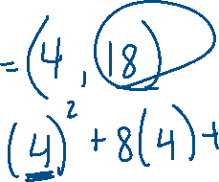
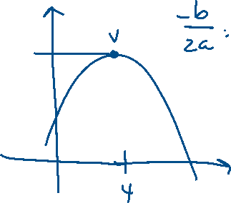
Ex 2: The function h(t) = -t² + 8t + 2 represents the height, in feet, of a stream of water being squirted out of a fountain after t seconds. What is the maximum height of the water?

Slide 7
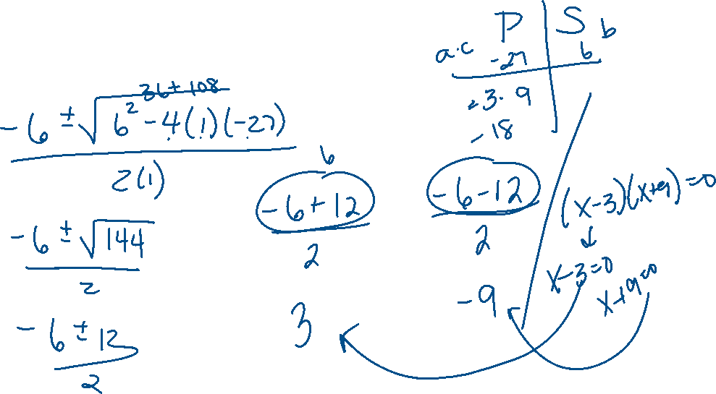
Ex 3: What are the zeros of the function represented by the quadratic expression x² + 6x – 27?

Slide 8
Create Equations that Describe Numbers or Relationships
Real-life problems?
Finding the area
Product of consecutive integers
Finding the height of a projectile
Use properties of equality to solve for a variable
Graph using the vertex and zeros

Slide 9
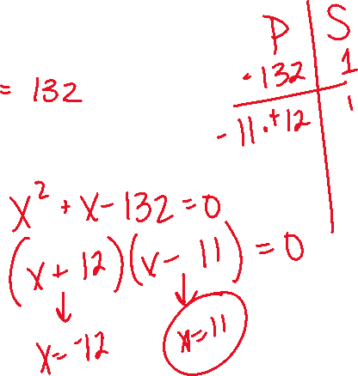
Ex 4: The product of two consecutive positive integers is 132. a. Write an equation to model the situation. b. What are the two consecutive integers?

Slide 10
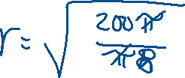
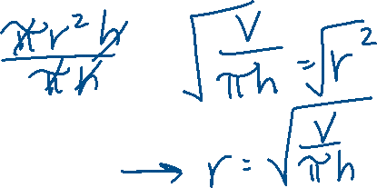
Ex 5: The formula for the volume of a cylinder is V = πr²h. a. Solve the formula for r. b. If the volume of a cylinder is 200π cubic inches and the height of the cylinder is 8 inches, what is the radius of the cylinder?

Slide 11
Solving Equations and Inequalities in One Variable
4 Methods: Factoring, Square Root, Complete the Square, Quadratic Formula
Remember, every square root has a positive and a negative value ( + ).
Quadratic Formula:

Slide 12
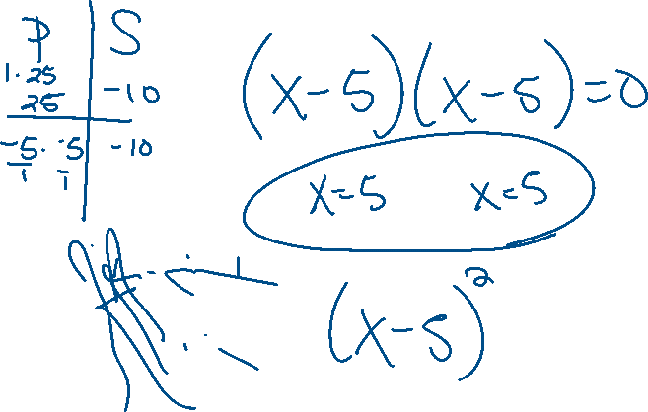
Ex 6: Solve the equation x² – 10x + 25 = 0 by factoring.

Slide 13
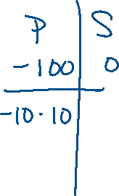
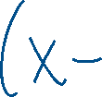
Ex 7: Solve the equation x² – 100 = 0 by using square roots.

Slide 14
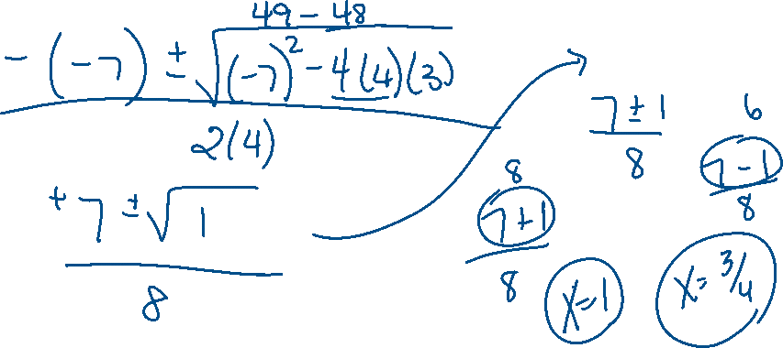
Ex 8: Solve the equation 4x² – 7x + 3 = 0 using the quadratic formula.

Slide 15
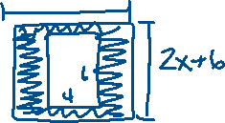
Ex 9: Annie is framing a photo with a length of 6 inches and a width of 4 inches. The distance from the edge of the photo to the edge of the frame is x inches. The combined area of the photo and frame is 63 square inches. Write a quadratic function to find the distance from the edge of the photo to the edge of the frame. How wide are the photo and frame together?

Slide 16
Build New Functions from Existing Functions
A parent function is the basic function from which all other functions in a function family are modeled.
For the quadratic function family, the parent function is f(x) = x².
Transformations: f(x) = a(x - h)² + k
An even function is symmetric about the y-axis.
An odd function is symmetric about the origin.

Slide 17
Ex 10: Compare the graphs of the following functions to f(x). a. ½ f(x) b. f(x) – 5 c. f(x – 2) + 1

Slide 18
Ex 11: Is f(x) = 2x³ + 6x even, odd, or neither? Explain how you know.

Slide 19
Interpret Functions in Context
When examining a function, we look at the following features:
Domain
Range
x-intercept/root/zero
y-intercept
interval of increasing, decreasing, constant
Minimum or Maximum
Average Rate of Change
End Behavior

Slide 20
Ex 12: A ball is thrown into the air from a height of 4 feet at time t = 0. The function that models this situation is h(t) = -16t² + 63t + 4, where t is measured in seconds and h is the height in feet. a. What is the height of the ball after 2 seconds? b. When will the ball reach a height of 50 feet? c. What is the maximum height of the ball? d. When will the ball hit the ground? e. What domain makes sense for the function?

Slide 21
Analyze Functions Using Different Representations
Be able to identify key features of a function regardless if you have the graph, table, or equation.
If you are comparing functions, create graphs or tables so you can see how each graph is changing.

