Slide 1
GSE Algebra I
Unit 2/3 Review

Slide 2
Unit 2: Reasoning with Linear Equations and Inequalities
Key Ideas
Solving Equations and Inequalities in One Variable
Solving a System of Two Linear Equations
Represent and Solve Equations and Inequalities Graphically
Build a Function that Models a Relationship between Two Quantities
Understand the Concept of a Function and Use Function Notation
Interpret Functions that arise in Applications in Terms of the Context
Analyze Functions using Different Representations

Slide 3
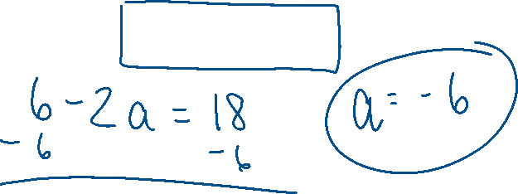
Solving Equations
Solving an equation or inequality means finding the quantities that make the equation or inequality true.
Ex: Solve 2(3 – a) = 18 for a.

Slide 4
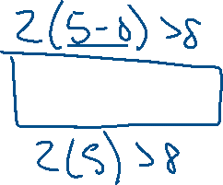
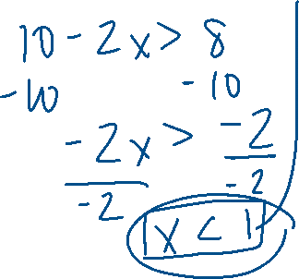
Solving Inequalities
Write equivalent expressions until the desired variable is isolated on one side.
If you multiply or divide by a negative number, make sure you reverse the inequality symbol.
Ex: Solve 2(5 – x) > 8 for x.

Slide 5
Properties of Equality
Addition Property
Multiplication Property
Multiplication Inverse Property
Additive Inverse Property
Tip: Sometimes eliminating denominators by multiplying all terms by a common denominator or common multiple makes it easier to solve an equation or inequality.

Slide 6
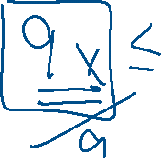
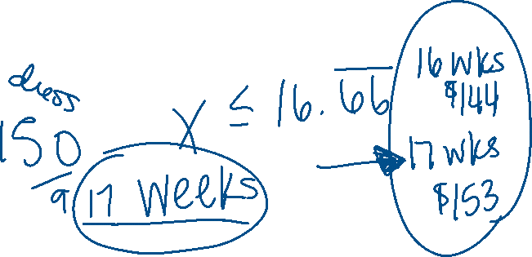
Ex 1: Karla wants to save up for a prom dress. She figures she can save $9 each week from the money she earns babysitting. If she plans to spend less than $150 for the dress, how many weeks will it take her to save enough money to buy any dress in her price range?

Slide 7
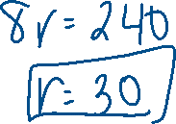
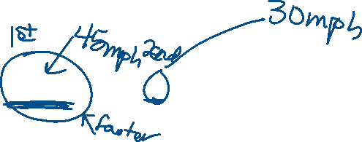
Ex 2: Two cars start at the same point and travel in opposite directions. The first car travels 15 miles per hour faster than the second car. In hours, the cars are 300 miles apart. Use the formula below to determine the rate of the second car. 4(r + 15) + 4r = 300 What is the rate, r, of the second car?

Slide 8
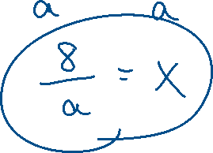
Ex 3: Solve the equation 14 = ax + 6 for x. Show and justify your steps.

Slide 9
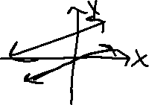
Solving a System of Two Linear Equations
Use tables or graphs as strategies for solving a system of equations. For tables, use the same values for both equations. For graphs, the intersection of the graph of both equations provides the solution to the system of equations.
3 Methods: Graphing, Substitution, Elimination
If in Standard Form, can use calculator.
Don’t forget about infinite solutions and no solution!

Slide 10
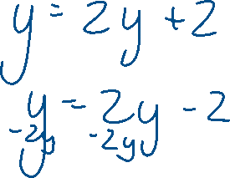
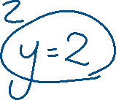
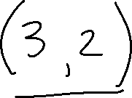
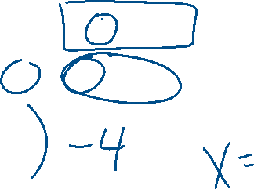
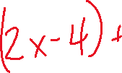
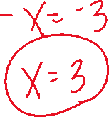
Ex 4: Solve this system of equations: y = 2x – 4 x = y + 1

Slide 11
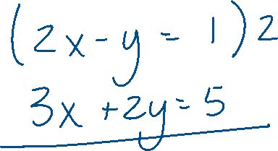
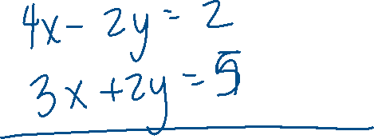
Ex 5: Solve this system of equations: 2x – y = 1 5 – 3x = 2y

Slide 12
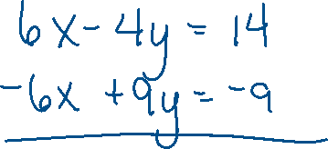
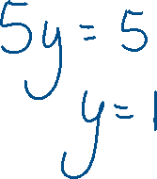
Ex 6: Solve this system of equations: 3x – 2y = 7 2x – 3y = 3

Slide 13
Solving Equations and Inequalities Graphically
Use table to help graph. Make sure your equation is in slope-intercept form.
When graphing inequalities, < or > is a dashed line, < or > is a solid line.
Don’t forget to choose a test point when graphing an inequality to determine shading.

Slide 14
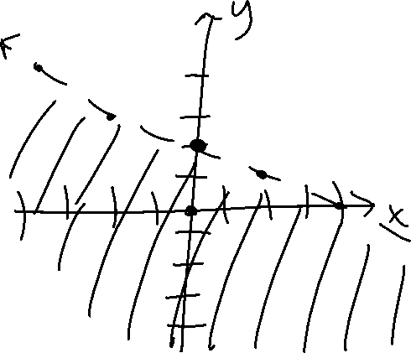
Ex 7: Graph the inequality x + 2y < 4.

Slide 15
Building a Function that Models a Relationship between two Quantities
A linear model for a function is f(x) = mx + b, where m and b are any real numbers and x is the independent variable.
Sometimes the data for a function is presented as a sequence. A sequence is an ordered list of numbers. Each number in the sequence is called a term.
The explicit formula for an arithmetic sequence is a_{n} = a₁ + d(n – 1)
The recursive formula for an arithmetic sequence is a_{n} = a_{n -1} + d , a₁= ?

Slide 16
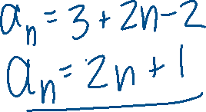
Ex 8: Rachel is eating cookies everyday after school for a week. She has eaten cookies in the following pattern: 3, 5, 7, 9, 11. Write a function for this scenario.

Slide 17
Functions and Function Notation
A relation is any set of input and output.
A function is a relation where every input is paired with one output.
Don’t forget about the Vertical Line Test!
The domain is the set of input values.
The range is the set of output values.
Function notation is f(x) and is another way of writing y.

Slide 18
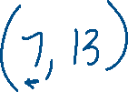
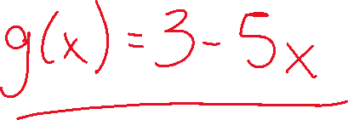
Ex 9: Given f(x) = 2x – 1, find f(7). Ex 10: If g(6) = 3 – 5(6), what is g(x)?

Slide 19
Interpret Functions in Context
When examining a function, we look at the following features:
Domain
Range
x-intercept
y-intercept
interval of increasing, decreasing, constant
Rate of Change
End Behavior

Slide 20
Ex 11: It takes a company 6.5 hours to set up the machinery to make engines and it takes 5.25 hours to manufacture each engine. Write a model for the production of engines then determine domain, range, x and y-intercepts, and rate of change.

Slide 21
Analyze Functions Using Different Representations
Be able to identify key features of a function regardless if you have the graph, table, or equation.
If you are comparing functions, create graphs or tables so you can see how each graph is changing.

