Slide 1
GSE Algebra I
Unit 1 Review

Slide 2
Unit 1: Relationships Among Quantities
Key Ideas
Properties of Rational and Irrational Numbers
Reason Quantitatively and Use Units to Solve Problems
Interpret the Structure of Expressions
Perform Arithmetic Operations on Polynomials

Slide 3
Rational Number
A real number that can be represented as a ratio p/q such that p and q are both integers and q does not equal zero.
All rational numbers can be expressed as a decimal that stops or repeats.
Ex: -0.5, 0, 7, 3/2, 0.266666666…

Slide 4
Irrational Number
A real number that cannot be expressed as a ratio.
Irrational numbers cannot be represented by decimals that stop or repeat.
Ex: √3, , √5/2

Slide 5
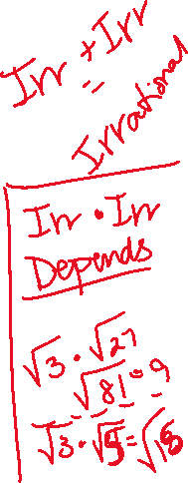
Sum and Product of Rational and Irrational Numbers
The sum of an irrational number and a rational number is always irrational.
The product of a nonzero rational number and an irrational number is always irrational.
The sum or product of rational numbers is rational.

Slide 6
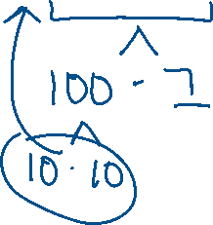
Ex 1: Rewrite in simplest form.

Slide 7
Ex 2: Is the sum of ½ and √2 a rational or an irrational number?

Slide 8
Ex 3: Is the product of -0.5 and √3 a rational or an irrational number? Explain your reasoning.

Slide 9
Quantity
An exact amount or measurement.
One type of quantity is a simple count, such as 5 eggs or 12 months.
A second type of quantity is a measurement, which is an amount of a specific unit. Examples are 6 feet and 3 pounds.

Slide 10
Level of Accuracy
A quantity can be exact or approximate. When an approximate quantity is used, it is important that we consider its level of accuracy.
For example, a dosage of medicine would need to be very precise.
An example of a measurement that does not need to be very precise is the distance from your house to a local mall.

Slide 11
Unit of Measure
If you want to calculate the diameter of the sun, you would want to choose a very large unit of measure of length, such as miles or kilometers.
Conversion of units can require approximations.

Slide 12
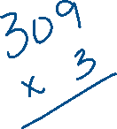
Ex 4: Convert 309 yards to feet.

Slide 13
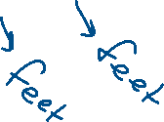
Ex 5: The cost, in dollars, of a single-story home can be approximated using the formula C = klw, where l is the approximate length of the home and w is the approximate width of the home. Find the units for the coefficient k.

Slide 14
Ex 6: Convert 45 miles per hour to feet per minute.

Slide 15
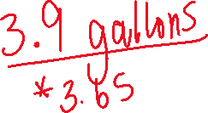
Ex 7: When Justin goes to work, he drives at an average speed of 65 miles per hour. It takes about 1 hour and 30 minutes for Justin to arrive at work. His car travels about 25 miles per gallon of gas. If gas costs $3.65 per gallon, how much money does Justin spend on gas to travel to work?

Slide 16
Important Tips
When referring to a quantity, include the unit or the items being counted whenever possible.
It is important to use appropriate units for measurements and to understand the relative sizes of units for the same measurement. You will need to know how to convert between units and how to round or limit the number of digits you use.
Use units to help determine if your answer is reasonable. For example, if a question asks for a weight and you find an answer in feet, check your answer.

Slide 17
Algebraic Expressions
An algebraic expression contains variables, numbers, and operation symbols.
A term in an algebraic expression can be a constant, variable, or constant multiplied by a variable or variables. Every term is separated by a plus sign.
A coefficient is the constant number that is multiplied by a variable in a term.
Factors are numbers multiplied together to get another number.
A common factor is a variable or number that terms can be divided by without a remainder.

Slide 18
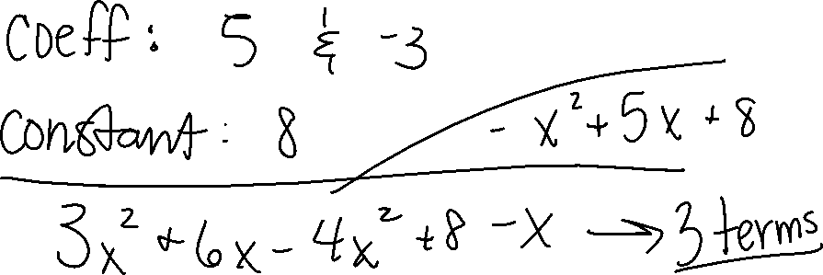
Ex 8: Identify the terms, coefficients, and constants of the expression 5x² – 3x + 8.

Slide 19
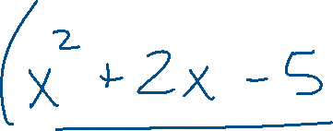
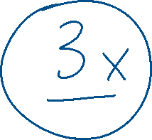
Ex 9: Identify the common factor of the expression 3x³ + 6x² – 15x.

Slide 20
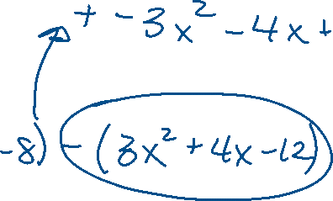
Operations on Polynomials
A polynomial is an expression made from one or more terms that involve constants, variables, and exponents.
To add and subtract polynomials, combine like terms. In a polynomial, like terms have the same variables and are raised to the same powers.
To multiply polynomials, use the Distributive Property. Multiply every term in the first polynomial by every term in the second polynomial. To completely simplify, add like terms after multiplying.

